Slide 1
SCEL Fraud Detection Analysis
Presented by: Dushyant Bhatia, Noah Cornelius, Rohit Chaudhari, Tianlin Tan

Slide 2
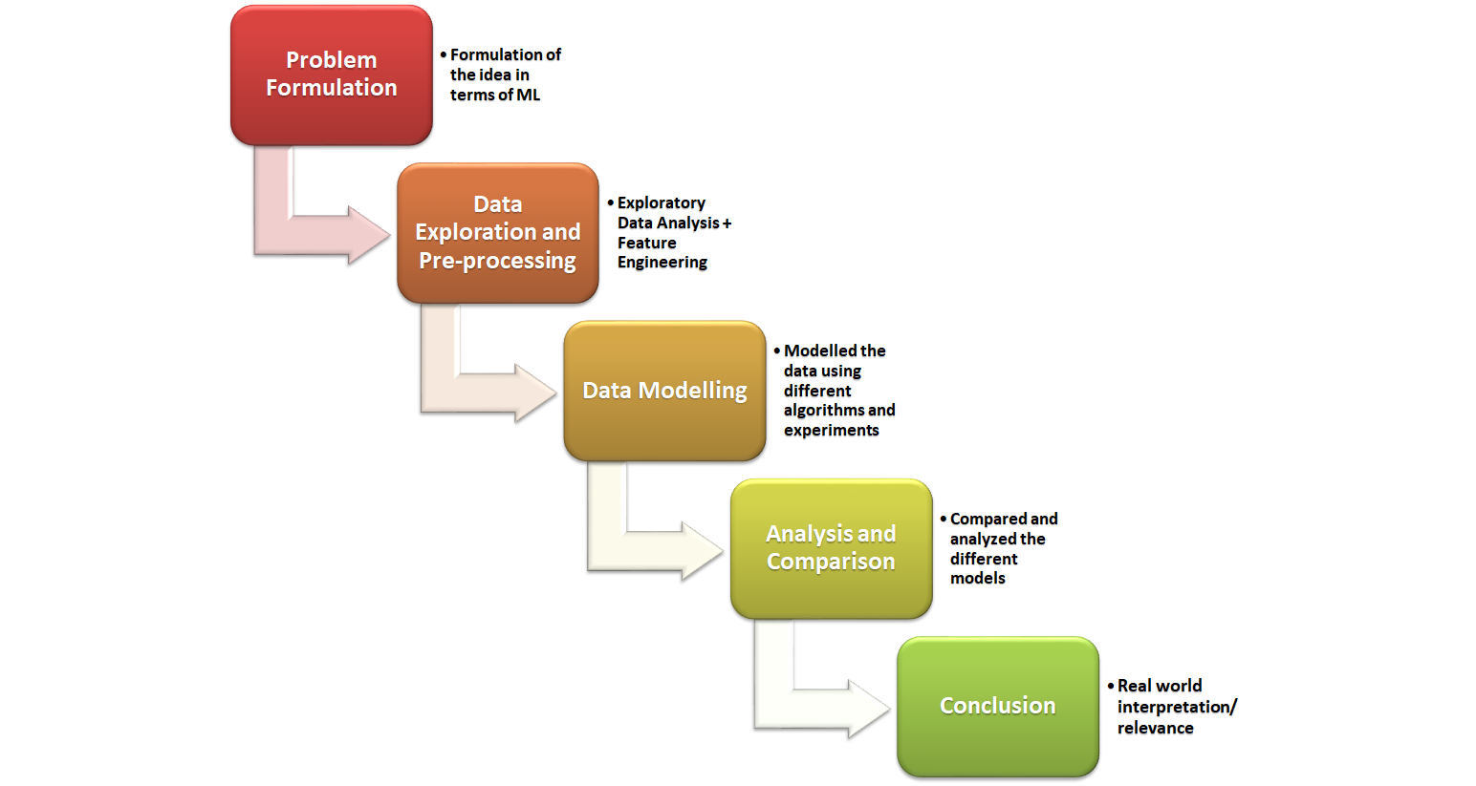
Project Lifecycle

Slide 3
Project Overview
2 datasets: Retailer daily sales and “Detected” fraud
Develop an algorithm to identify retailer outliers which may indicate involvement in illicit activities.
Challenges
Super Imbalanced dataset (<0.2% “fraud” of the total)
Insufficient sales dataset, cannot distinguish between sales and validations (different locations)

Slide 4
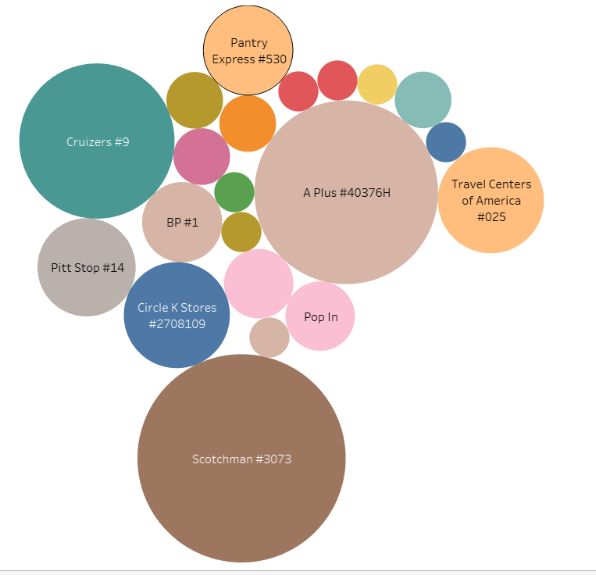
Data Glimpse 1
Which retailer has the
most detected fraud cases?

Slide 5
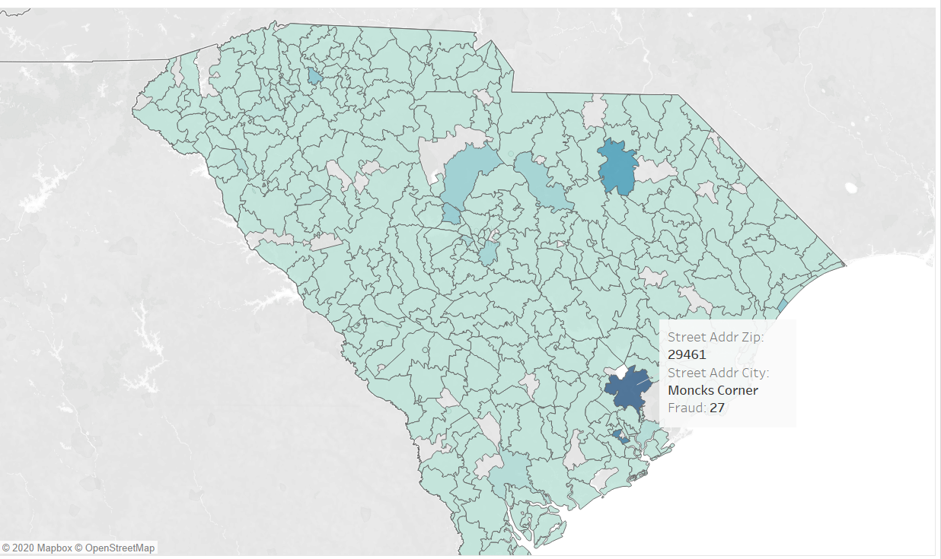
Data Glimpse 2
Where is the
Scotchman located?

Slide 6
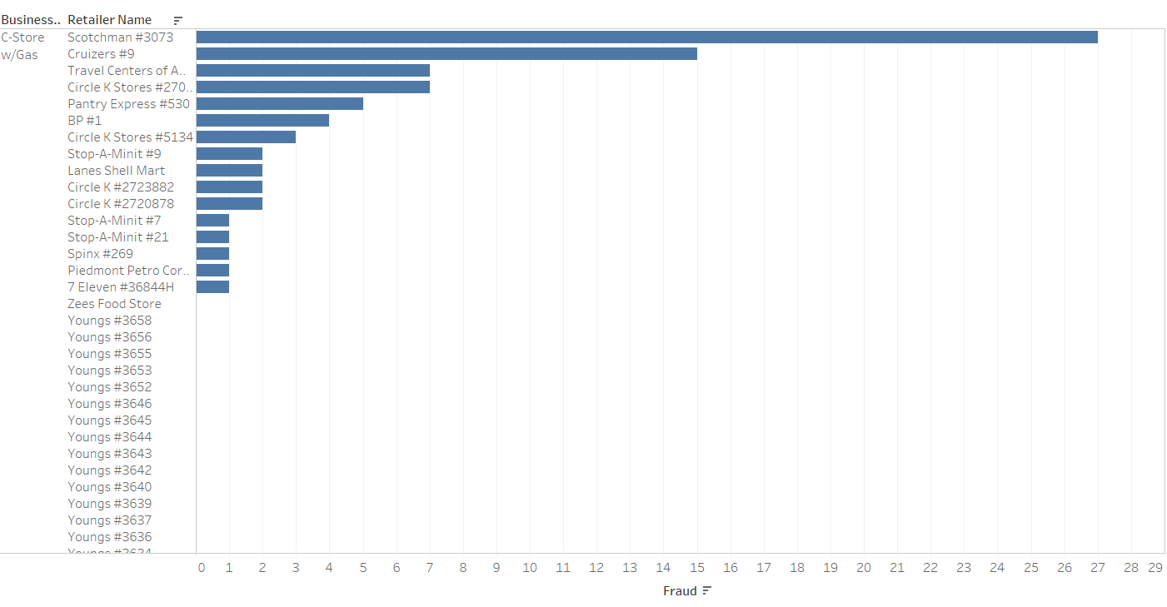
Data Glimpse 3
What type of business
the Scotchman is?

Slide 7
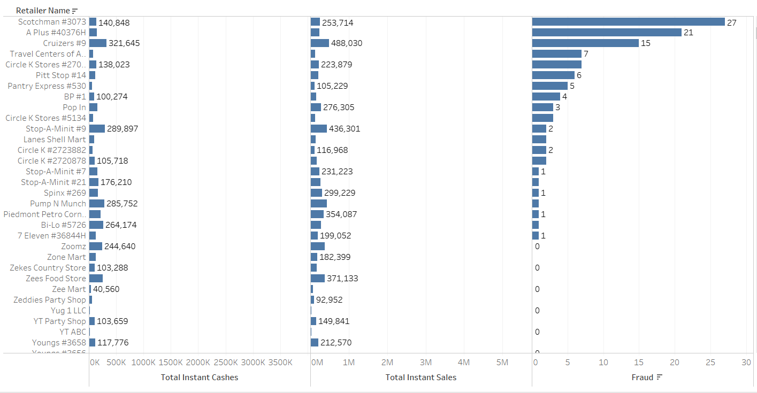
Data Glimpse 4

Slide 8
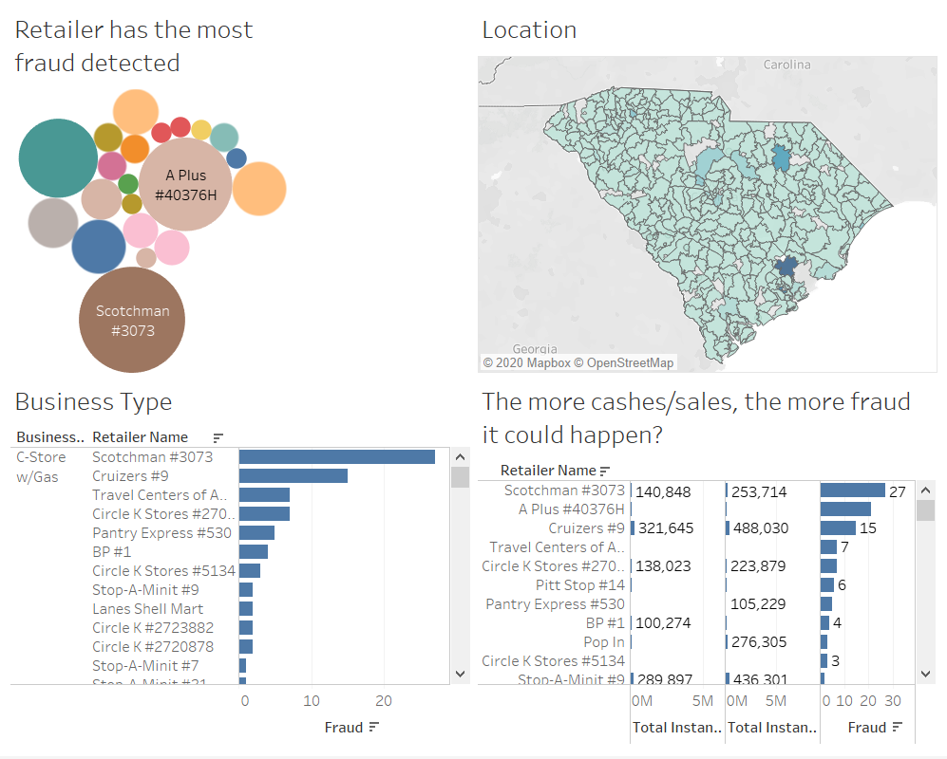
A Working
Dashboard

Slide 9
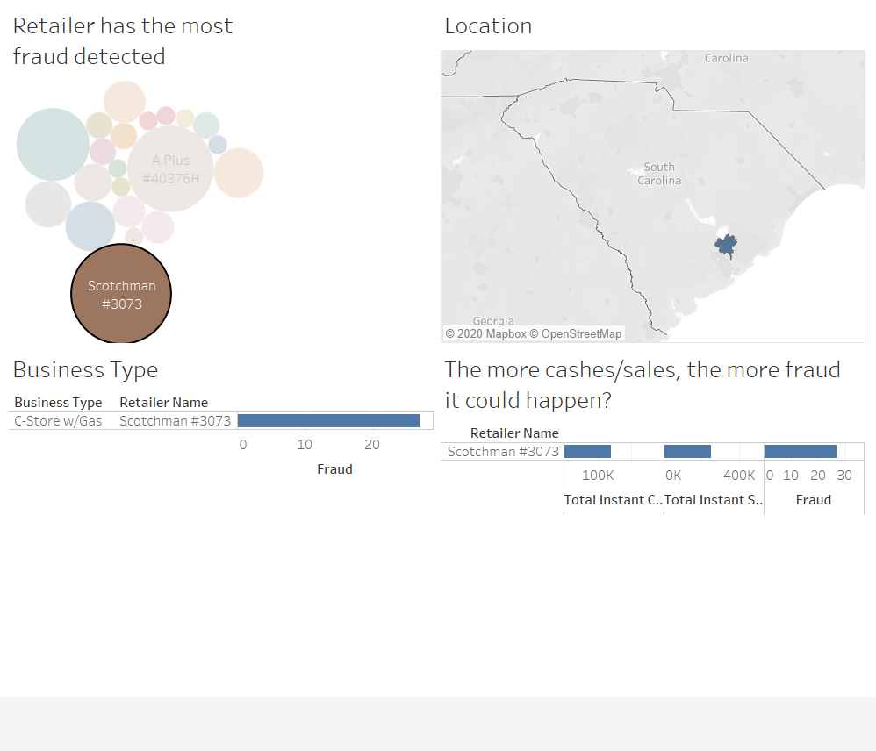
A Working
Dashboard

Slide 10
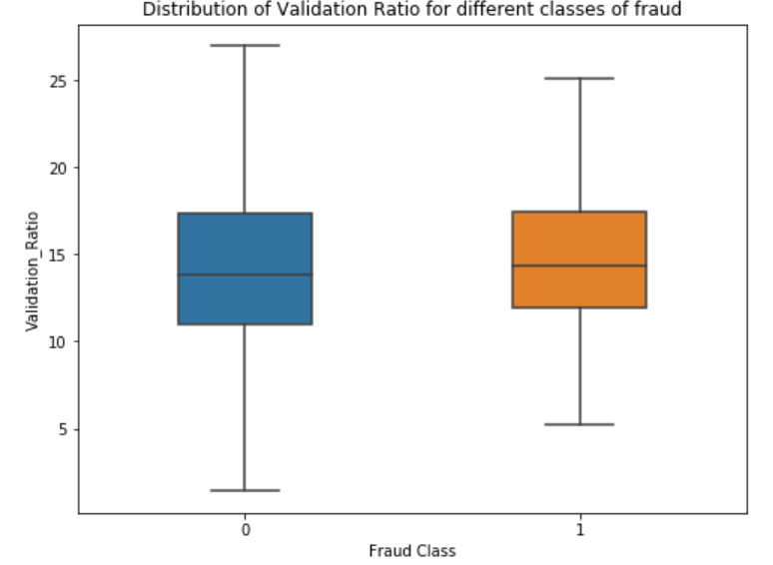
EDA : Feature Engineering
Feature 1: Cashes Ratio [Total Instant Cashes / Instant Cashes Count]
The plot represents the distribution of the new engineered feature, “Cashes ratio”.
The graph shows different spread of the feature for the two classes (fraud and not fraud).
Although their median lies about the same point, the distribution is little different adding value to the model.

Slide 11
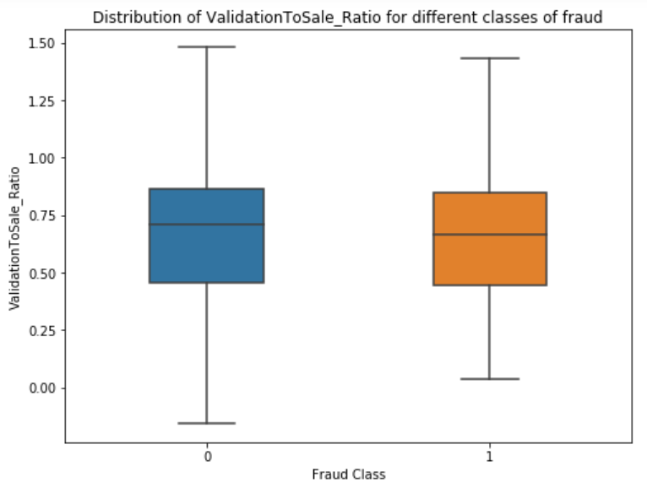
EDA : Feature Engineering
Feature 2: Cashes To Sales Ratio [Total Instant Cashes/ Total Instant Sales]
The plot represents the distribution of the new engineered feature, “Cashes to sales ratio”.
The graph shows different spread of the feature for the two classes (fraud and not fraud).
Although their median lies about the same point, the distribution is little different adding value to the model.

Slide 12
Model Experiments
Experiment 1: Complete Data Model
Algorithms applied
In case of Imbalanced data sets : Accuracy is fallacy
Precision represents the accuracy of the model's predicting, i.e., percentage of accurate predictions out of total fraud predictions
Recall represents the percentage of actual fraud cases captured by the model
Algorithm | Accuracy Train | Test | Precision (Fraud class) Train | Test | Recall (Fraud class) Train | Test
Gradient Boosting | 0.98 | 0.99 | 0.98 | 0.11 | 0.16 | 0.11
Logistic Regression | 0.98 | 0.99 | 0.50 | 0.0 | 0.01 | 0.0
Support Vector Machine | 0.98 | 0.99 | 0 | 0 | 0 | 0

Slide 13
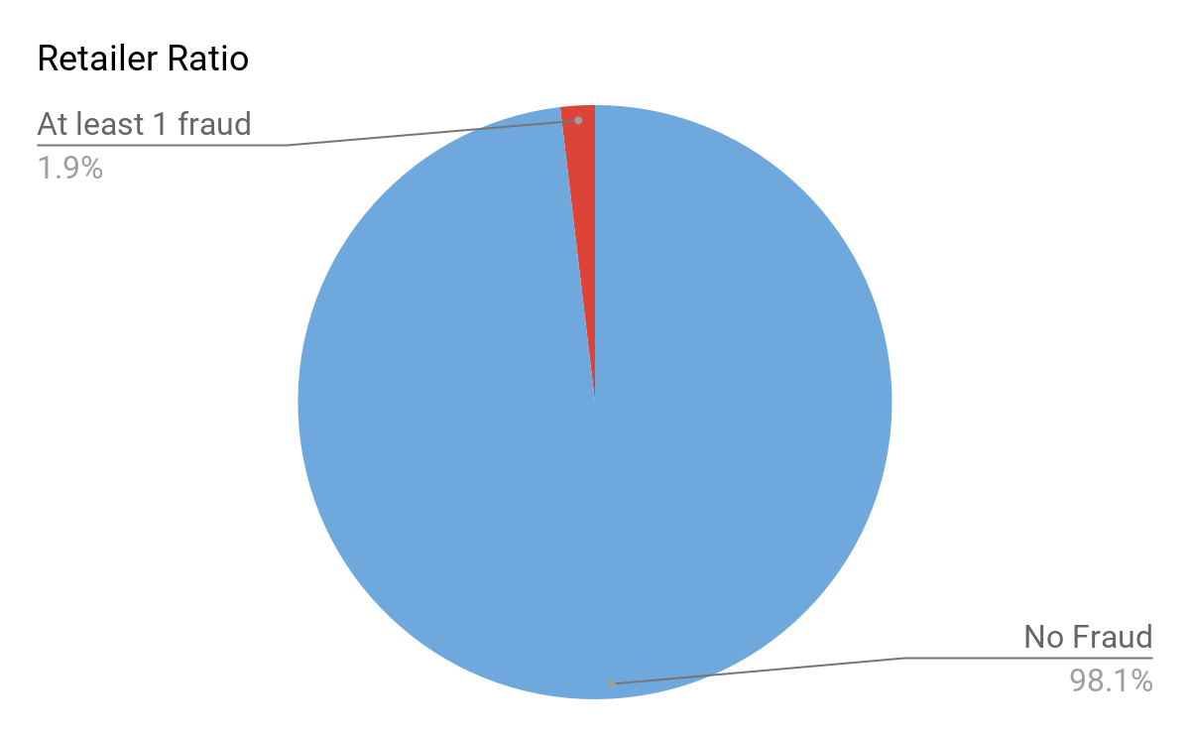
Model Experiments
Experiment 2: Using data of retailers having fraudulent transactions
Retailers | Count
Retailers with no fraud | 4411
Retailers who have committed fraud at least once | 84

Slide 14
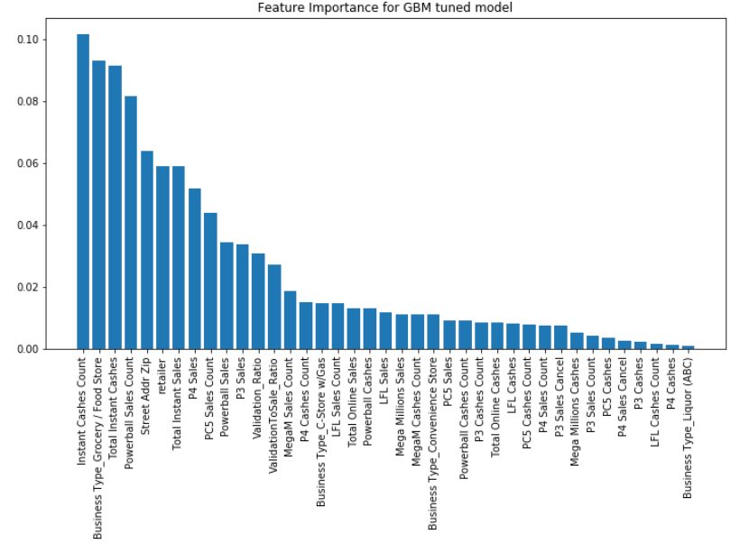
Model Experiments
Experiment 2: Using data of retailers having fraudulent transactions
Chart represents the relative importance of the features for the GBM Model
Most Important feature for the model is ‘Instant Cashes Count’
Also, it can be noticed that both of the new engineered features are in the Top 10 /15 features, thus adding value to the model

Slide 15
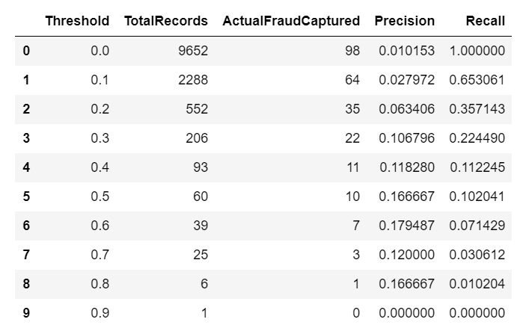
Model Experiments
Experiment 2: Using data of retailers having fraudulent transactions
Threshold Analysis:
Discussing GBM results
Putting threshold over the model's output probabilities help in managing the trade off between precision and recall for the fraud class
As can be seen from the graph, threshold of 0.4 and 0.5 makes sense from business perspective
By predicting 93 records as fraud out of total 9652 test data points here, model was able to correctly identify 11 fraud cases

Slide 16
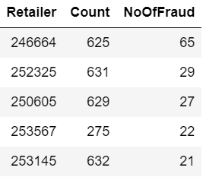
Model Experiments
Experiment 3: Retailer specific model
Top 5 Retailers involved in illicit activities
Total unique retailers : 4495
No of models : 4495
Tried for top 5

Slide 17
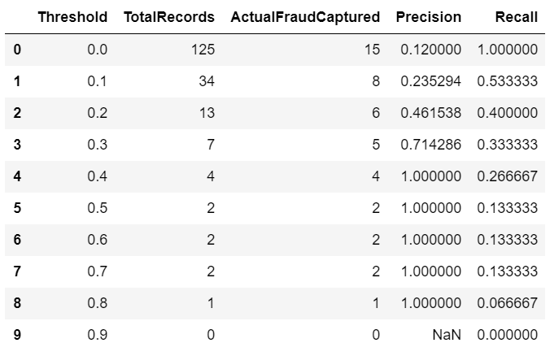
Model Experiments
Experiment 3: Retailer specific model
Retailer Id : 246664
Threshold Analysis
Comparing the results with that of a single model, we can see a boost in the performance
At threshold of 0.3, model has a high precision of 0.71 and recall of 0.33

Slide 18
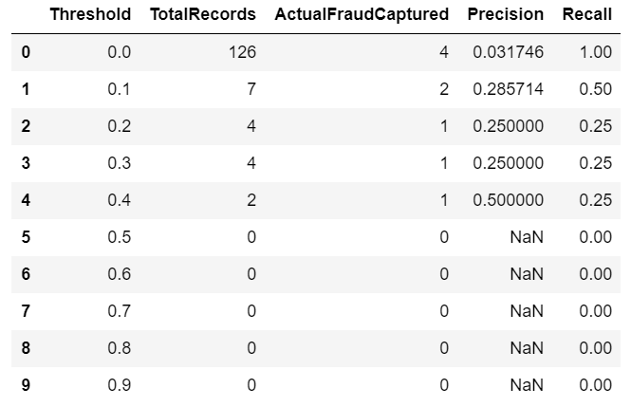
Model Experiments
Experiment 3: Retailer specific model
Retailer Id : 250605
Threshold Analysis
Comparing the results with that of a single model, we can see a boost in the performance
At threshold of 0.4, model has a high precision of 0.50 and recall of 0.25

Slide 19
Model Experiments
Real World Application: Reducing Manual Efforts
For the real world application, we believe that the final model (or a system of models) can be used to reduce the manual effort
Based on the model's output, we can have a risk threshold associated with it to highlight the transaction as high risk (red), medium risk (yellow) or low risk (green)
Alerts can be generated based on the level of risk and sent to the concerned department
High Risk Medium Risk Low Risk

Slide 20
Geographical Data - Interim Solution
Aid for Human Intervention
Threshold analysis will allow us to identify high risk retailers at the time a ticket is sold
When high risk clients are predicted we can provide other retailers in surrounding location, which may provide a fraudulent validation
Unproven metric to provide supporting evidence

Slide 21
Going Forward
What we’ve learned from what we haven’t learned
Clarify business objective
When ticket is sold vs. when ticket is validated
Entertain predetermined cashing statistics
How often are people supposed to win given what batch their ticket was purchased from?
Is it ideal to track every lottery ticket SCEL sells?
Is the effort worth the profit from this perspective?
Build different models based on the business type
Different businesses have different behaviors

Slide 22
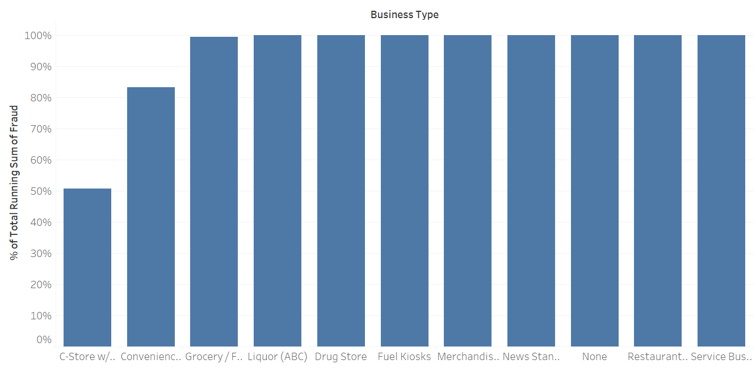
Idea to be implemented
Pareto principle- 80% are frauds committed by 20% Business Type

Slide 23

Thank You!

